Slide 1
Why storage ?

Slide 2

Storage Options
Magnetic Tape
  Low cost solution for long term data storage
    Preferred option for backup destination in the past.
  Limitations
  Data is stored on the tape linearly along with length of the tape
  Sequential data access
  Single application access at a time
  Physical wear and tear
    Storage/retrieval overheads
Notes:
Module 2: Data Center Environment

Slide 3
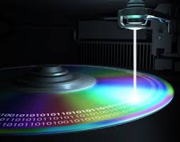
Storage Options (contd.)
Optical discs
  Popularly used as distribution medium in small, single-user computing environments.
  Frequently used by individual to store photos or backup on personal or laptop computer
  Distributed medium for small application(games)
  Limited in capacity and speed
  Write once and read many (WORM): CD-ROM, DVD-ROM
Notes:
Module 2: Data Center Environment

Slide 4
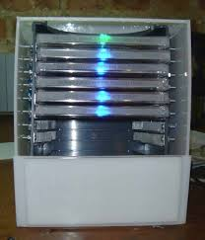
Storage Options (contd.)
  Optical discs
  Collections of optical discs in an array, called as jukebox, are still used as a fixed content storage solution.
  X-rays, MRIs and CAT scans; CAD/CAM diagrams and blueprints and e-mail messages.
  Other variations: CD-RW, Blu-ray discs

Slide 5
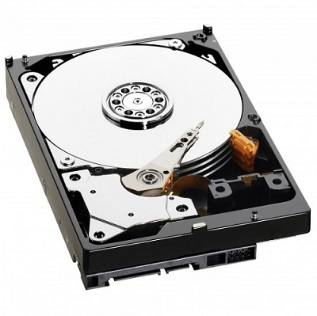

Storage Options (contd.)
Disk drive
  Most popular storage medium
  Data can be written and retrieved quickly for simultaneous applications
  It supports rapid access to random data location.
  Large storage capacity
Flash drives
  Uses semiconductor media
  Provide high performance and low power consumption

Slide 6
Disk Drive Components
The key components of Hard disk drive
Platter
Spindle
Read – write head
Actuator arm assembly
Controller board

Slide 7
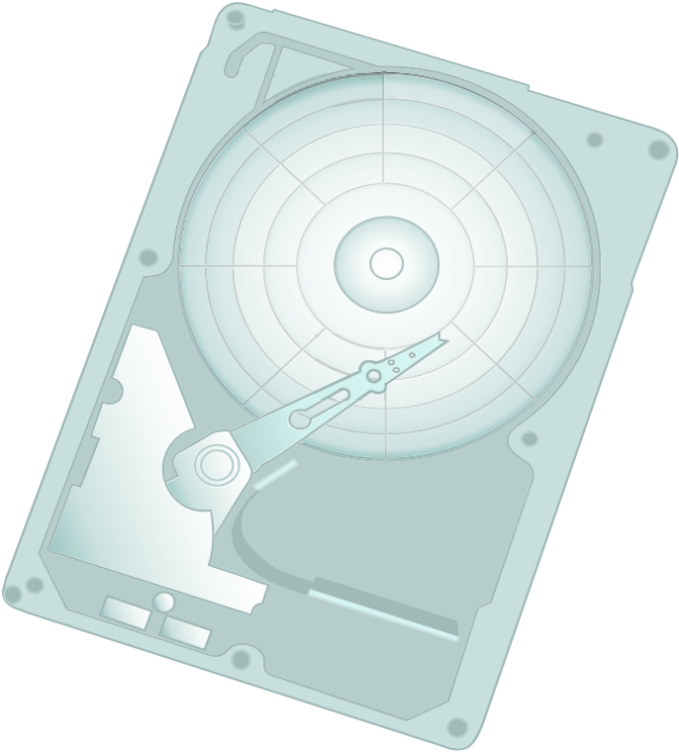

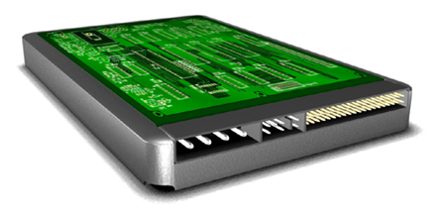
Disk Drive Components
Read/Write head
Controller
Board
HDA
Actuator
Platter
Actuator Arm
Interface
Power
Connectors
Spindle
Module 2: Data Center Environment
Notes:
Module 2: Data Center Environment

Slide 8
Disk Drive Components
I/O operations in a HDD performed by rapidly moving the arm across the flat rotating flat platters coated with magnetic tapes
Data is transferred between the controller and magnetic platters through read write head.

Slide 9
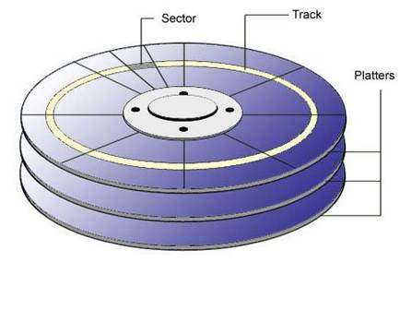
Platter
A typical HDD consist of one or more flat circular disk is called platter
The data is recorded on this platter is binary codes
A platter is a rigid , round disk coated with magnetic material On both surface
Data can be written to or read from both surface of platter
The number of platters determine the total capacity of disk

Slide 10
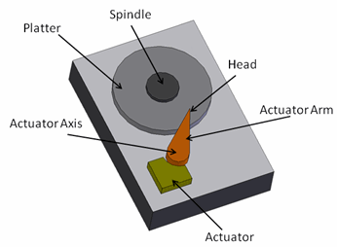
Spindle
It connects all the platters and it connected to motor
The motor of the spindle rotates with a constant speed
Common spindle speeds are 5,400 rpm, 7200 rpm,10,000 rpm,15,000 rpm.
Read/Write Head
Read/write data from or to platters
Drives have two R/W heads per platter one for each surface of the platter

Slide 11
Actuator Arm Assembly
R/W heads are mounted on the actuator arm assembly
Which is used to positions the R/w head at the location of the platter
Drive controller board
The controller is a printed circuit board , mounted at the bottom of a disk drive
It consist of a microprocessor, internal memory, circuit and firm ware.
The firmware controls the power to the spindle and speed of the motor
It controls the R/W operations by moving the actuator arm switching between different R/W heads , and performs data access

Slide 12


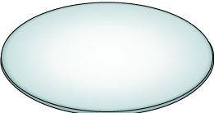
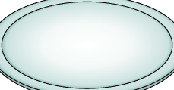
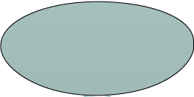



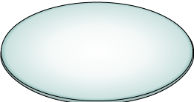
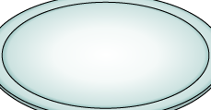
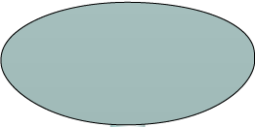




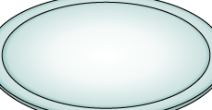



Physical Disk Structure
Spindle
Sector
Track
Cylinder
Module 2: Data Center Environment
Notes:
Module 2: Data Center Environment

Slide 13
Physical disk structure
Data on the disk recorded from the track, which is concentric rings on the platter around the spindle
Each track is divided in to smaller units called sectors
The first personal computer disk had 17 sectors per track
A Block hold 512 bytes of user data
A block data stores other information sector number, head number, or platter number and track number.

Slide 14

Logical Block Addressing
Sector 8
Block 0
Head 0
(Upper Surface)
Cylinder 1
Block 32
(Lower Surface)
Block 64
Block 128
Physical Address= CHS
Logical Block Address= Block#
Module 2: Data Center Environment
Notes:
Module 2: Data Center Environment

Slide 15
RAID
Why RAID
Performance limitation of a single drive disk drive
  Limited Capacity
  Limited access speed
  No fault tolerance
  RAID was introduced to mitigate this problem

Slide 16
RAID
RAID was defined as redundant array of inexpensive disks, now commonly redundant array of independent disks
It combines multiple physical disk drive components into a single logical unit

Slide 17
RAID Advantages
Fault tolerance
Increase capacity
Higher availability
Increased performance
Data redundancy

Slide 18
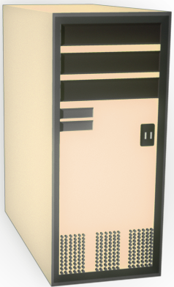

RAID Array Components
Physical Array
Logical Array
RAID
Controller
Hard Disks
Host
RAID Array
Notes:
Copyright © 2009 EMC Corporation. Do not Copy - All Rights Reserved.
Data Protection: RAID
- <number>

Slide 19
RAID Array Components
RAID Array
RAID Controller
Physical disks

Slide 20
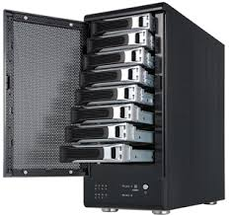
RAID Array

Slide 21
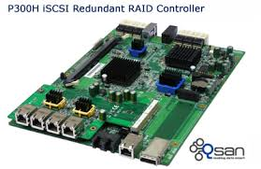
RAID Controller

Slide 22
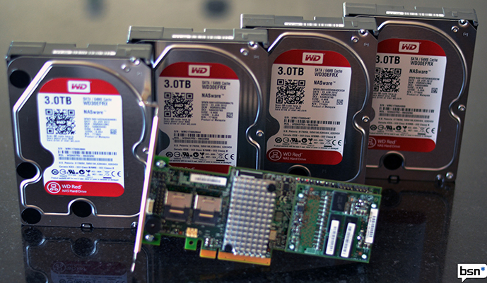
RAID Implementation Techniques
Software RAID
Hardware RAID

Slide 23
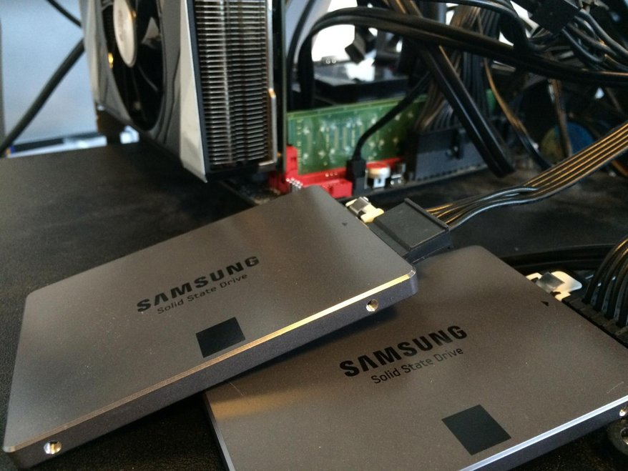
Software RAID
  Software RAID uses host-based software to provide RAID function.
  Runs as part of the operating system
  Performance is dependent on CPU workload
  Does not support all RAID levels

Slide 24
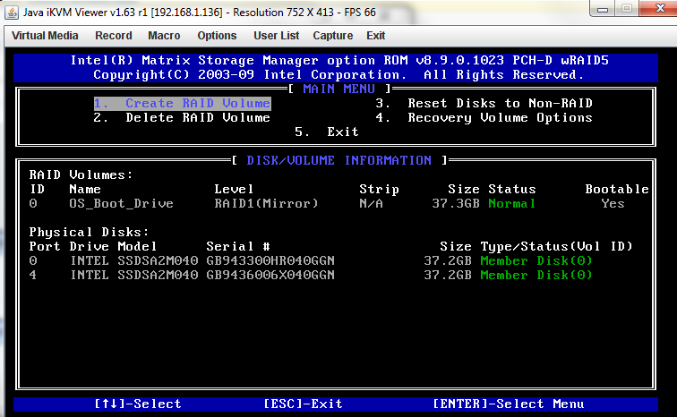

Slide 25
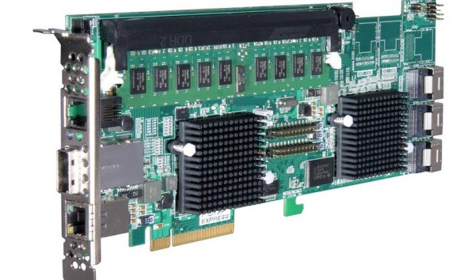
Hardware RAID
In this technique , a specialized hardware controller is implemented either on the host or on the array.
  Controls all drives attached to it
  Translation of I/O requests between logical disks and physical disks
  Data regeneration in the event of disk failures.

Slide 26
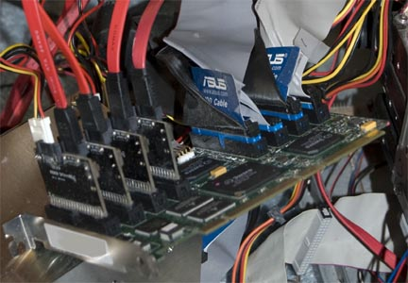

Slide 27
RAID comparison
Software RAID | Hardware RAID
Low performance | High performance
Low cost | High cost
Does not need RAID controller | RAID controller needed
Does not supports all RAID levels(RAID 0,1) | Supports all RAID levels
Data Protection: RAID
- <number>

Slide 28
RAID techniques
Three key techniques used for RAID are:
  Striping
  Mirroring
  Parity

Slide 29
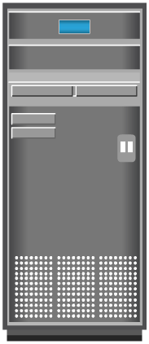

RAID Technique – Striping
Strip
RAID
Controller
Stripe
Host

Slide 30

RAID Technique – Mirroring
Block 0
RAID
Controller
Block 0
Block 0
Host

Slide 31

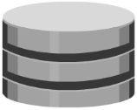
RAID Technique – Parity
4
D₁
6
D₂
RAID
Controller
1
D₃
7
Host
D₄
A XOR B = Parity
A XOR Parity = B
B XOR Parity = A
18
P
Actual parity calculation is a bitwise XOR operation

Slide 32
RAID Levels
Commonly used RAID levels are:
  RAID 0 – Striped set with no fault tolerance
  RAID 1 – Disk mirroring
  RAID 1 + 0 – Nested RAID
  RAID 3 – Striped set with parallel access and dedicated parity disk
  RAID 5 – Striped set with independent disk access and a distributed parity
  RAID 6 – Striped set with independent disk access and dual distributed parity

Slide 33
RAID 0
C
B
A
Data from host
RAID Controller
A1
A2
A3
A4
A5
B1
B2
B3
B4
B5
C1
C2
C3
C4
C5
Data Disks

Slide 34
RAID 1
F
E
D
C
B
A
Data from host
RAID Controller
A
A
D
D
B
B
E
E
C
C
F
F
Mirror Set
Mirror Set

Slide 35
Nested RAID – 1+0
C
B
A
Data from host
Striping
RAID Controller
Mirroring
Mirroring
Mirroring
A1
A1
A2
A2
A3
A3
B1
B1
B2
B2
B3
B3
C1
C1
C2
C2
C3
C3
Mirror Set A
Mirror Set B
Mirror Set C

Slide 36
RAID 3
C
B
A
Data from host
RAID Controller
A1
A2
A3
A4
A_{P}
B1
B2
B3
B4
B_{P}
C1
C2
C3
C4
C_{P}
Data Disks
Dedicated Parity Disk

Slide 37
RAID 5
C
B
A
Data from host
RAID Controller
A1
A2
A3
A4
A_{P}
B1
B2
B3
B_{P}
B4
C1
C2
C_{P}
C3
C4
Distributed Parity

Slide 38
RAID 6
C
B
A
Data from host
RAID Controller
A1
A2
A3
A_{P}
A_{Q}
B1
B2
B_{P}
B_{Q}
B3
C1
C_{P}
C_{Q}
C2
C3
Dual Distributed Parity

Slide 39
THANK YOU

